Slide 1
CLASS Simulations Moisture Budget
Atmospheric Simulations
Nadia Kairaktidi
1068622

Slide 2



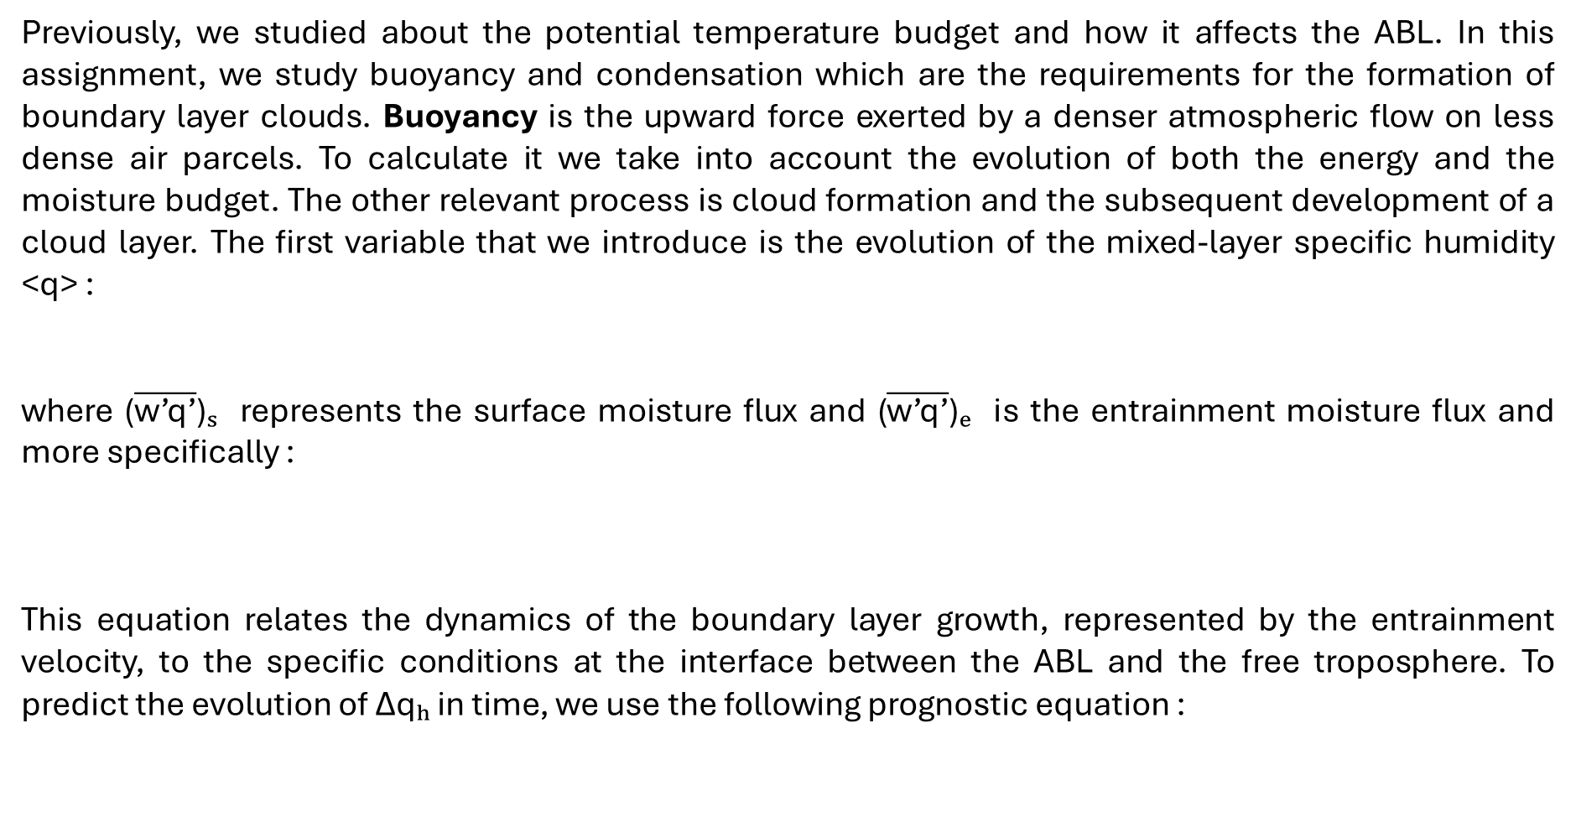
Governing Equations for Moisture
Previously, we studied about the potential temperature budget and how it affects the ABL. In this assignment, we study buoyancy and condensation which are the requirements for the formation of boundary layer clouds. Buoyancy is the upward force exerted by a denser atmospheric flow on less dense air parcels. To calculate it we take into account the evolution of both the energy and the moisture budget. The other relevant process is cloud formation and the subsequent development of a cloud layer. The first variable that we introduce is the evolution of the mixed-layer specific humidity <q> :
where ($\overline{\text{w}\text{’}\text{q}\text{’}}$)ₛ represents the surface moisture flux and ($\overline{\text{w}\text{’}\text{q}\text{’}}$)ₑ is the entrainment moisture flux and more specifically :
This equation relates the dynamics of the boundary layer growth, represented by the entrainment velocity, to the specific conditions at the interface between the ABL and the free troposphere. To predict the evolution of Δqₕ in time, we use the following prognostic equation :

Slide 3


The virtual potential temperature is the potential temperature that dry air would need to attain to have the same density as the moist air at the same pressure. It is a (nearly) conserved variable in an unsaturated ascent and it can be used as a surrogate to quantify buoyancy as it accounts for the changes in the potential temperature and moisture budgets. It is defined as :
Since moist air is less dense than dry air at the same conditions of temperature and pressure, θv is always greater than the actual temperature, but only by a few degrees. The turbulent transport of this variable, namely, the buoyancy flux, combines the information of the kinematic potential temperature flux and the specific moisture flux.
In the ABL, the buoyancy flux expresses the conversion of potential energy into turbulent kinetic energy as a result of temperature differences. The CBL is mainly driven by turbulence with a convective origin, so the buoyancy flux becomes the more important flux in the development of ABL under clear conditions.
The buoyancy flux directly enters into the ABL growth :

Slide 4

Determination of the Lifting Condensation Level
Water condenses in a height that is called lifting condensation level (LCL). Its estimation depends entirely on the absolute temperature and the specific humidity as a function of the pressure. Here, we calculate LCL as the height where an air parcel cooled adiabatically during its ascent reaches a relative humidity of 100 percent or when q = qₛₐₜ, where qₛₐₜ is the saturation specific moisture. If within the CBL saturation is reached, then clouds will be formed. To calculate LCL, we first calculate the saturation water vapour pressure eₛ using the Clausius-Clapeyron equation :
Then, we calculate the saturation specific humidity qₛₐₜ by multiplying with 0.622 and dividing with the pressure at each level. LCL is defined as the height where q is equal to qₛₐₜ. The time where h > LCL determines the onset of clouds.
In this assignment, we will study the sensitivity of the specific humidity and potential temperature to the initial inversion strength, in order to increase our understanding of the diurnal variability of the moisture budget, its close relation to the potential temperature budget, and their role in the determination of cloud formation.

Slide 5
Initial specific moisture jump: from dry to wet residual layersc
The evolution of the moisture budget during the night within the ABL can be very different from the budget at the free troposphere (h₊), which is normally decoupled from the surface processes occurring in the nocturnal boundary layer. The different values of q and qₕ₊, result in a jump of the specific moisture as defined by the following equation :
By imposing different values of Δq we are able to mimic the influence of the initial conditions (influenced by the nocturnal dynamics) on the diurnal evolution of the moisture budget.
We analyze the sensitivity of the moisture budget during the day to different values of this jump: from uniform conditions between the residual layer and the boundary layer Δq = 0 g kg−1 to very dry conditions in the residual layer Δq = −5 g kg−1 and we compare the values of <q>, Δq, and LCL for the different cases as can be seen on the following graphs.

Slide 6
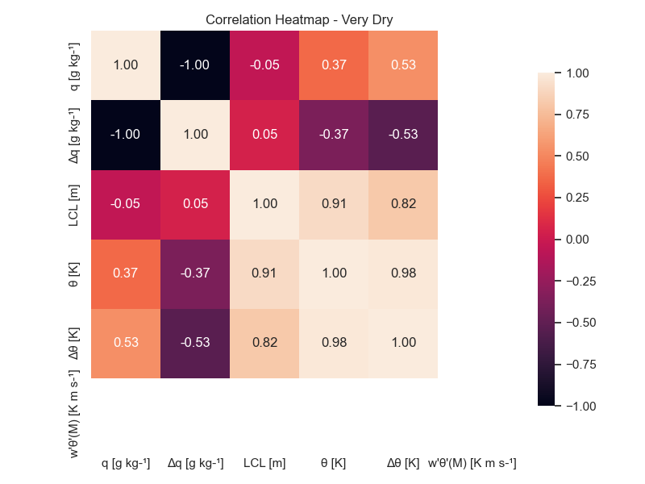
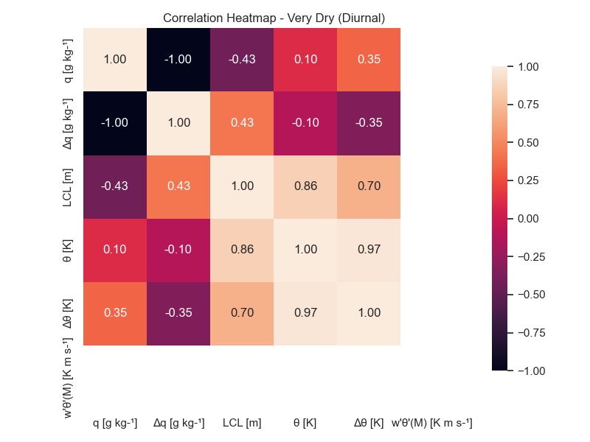

Slide 7
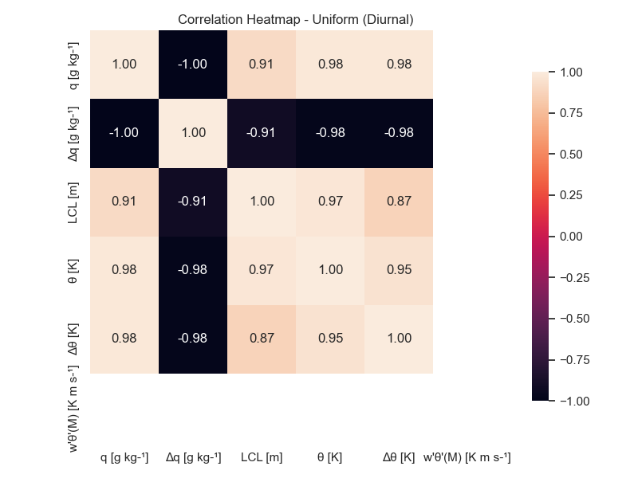
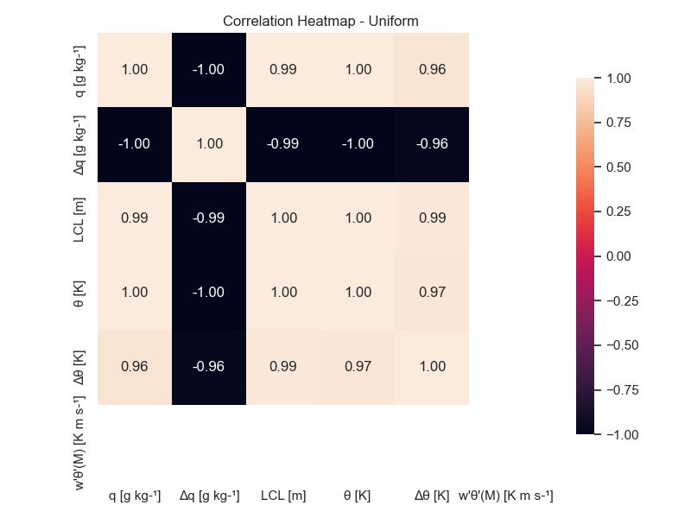

Slide 8
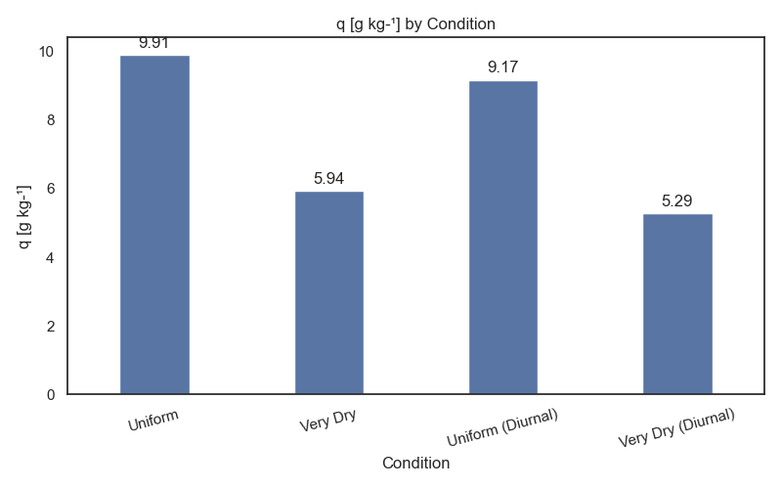

Slide 9
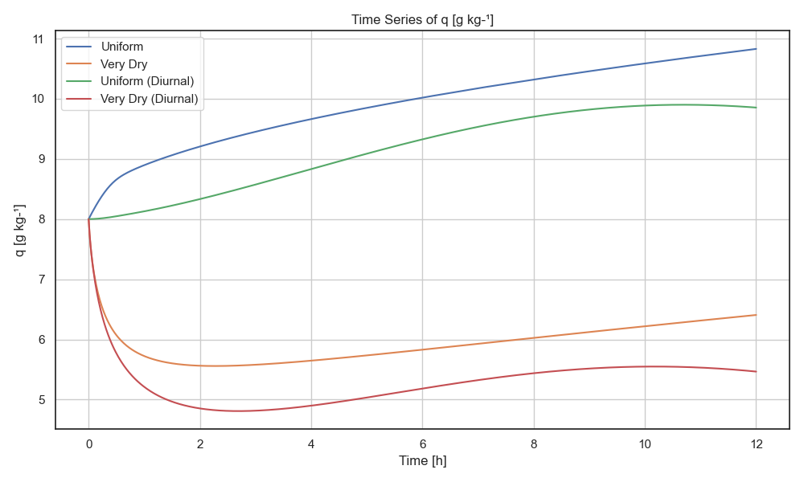

Slide 10
Is the potential temperature budget influenced by the different values of q?
Specific humidity q represents the moisture content in the atmosphere. When moist air rises and condenses, latent heat is released, which warms the air — affecting the potential temperature θ.
A positive correlation between these two suggests that higher moisture is associated with higher potential temperature — possibly due to latent heat release.
A weak or negative correlation may indicate that moisture doesn't strongly affect thermal structure under the given conditions.
From the correlation charts we see that those two variables are strongly correlated mainly in the uniform case and not as much when dry conditions prevail.
The bar plots show us how much specific humidity we have in each case. We notice that the diurnal cycle tends to reduce q due to early morning surface heating, which triggers strong turbulent mixing, draws in dry air from above, diluting near-surface moisture and can temporarily outpace any moisture flux from the surface.
In uniform conditions, q increases over time and the increase is slower than in the no-diurnal case, due to turbulent dilution.
In very dry conditions, the moisture budget is dominated by mixing. The dry surface provides little moisture flux, so once turbulence starts, q drops sharply. It slowly recovers later in the day, likely due to reduced mixing or slight recovery from weak surface fluxes

Slide 11
Is the potential temperature budget influenced by the different values of q?
Latent heating from condensation or moist convection depends on q.
In the diurnal dry case, less q means:
Less potential for latent heating
Higher LCL, more stable lower atmosphere
Possibly reduced turbulent buoyancy fluxes

Slide 12
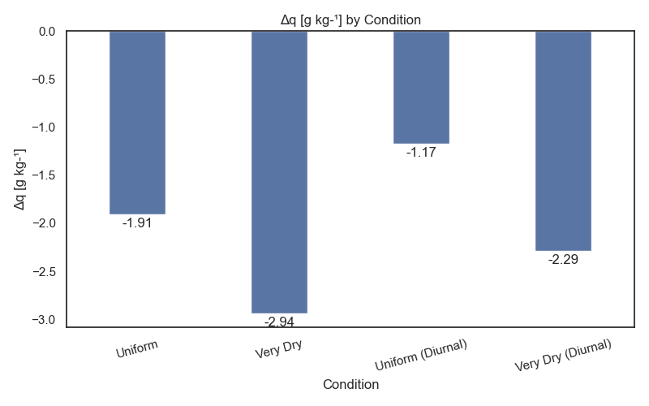

Slide 13
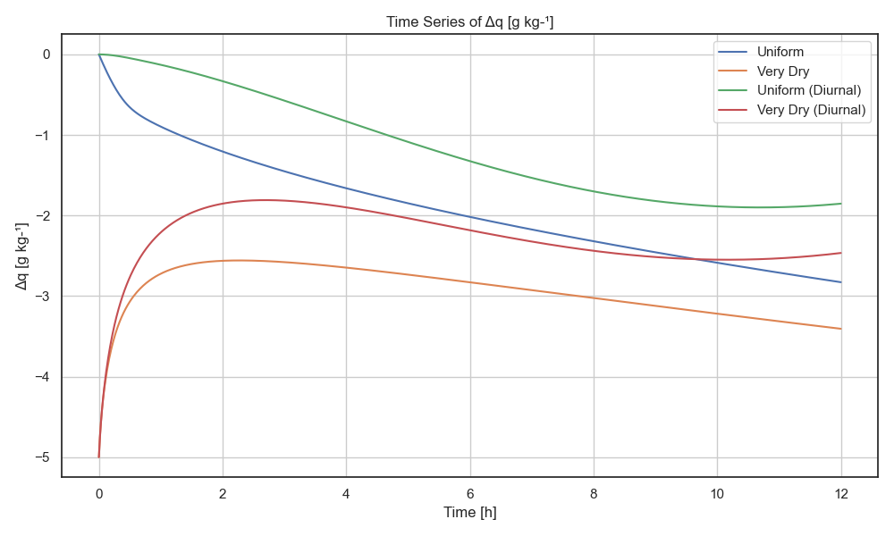

Slide 14
Is the potential temperature budget influenced by the different values of Δq?
Moisture gradient Δq and Δθ both represent vertical gradients — of moisture and temperature respectively. These gradients are critical in determining atmospheric stability.
A positive correlation suggests that a stronger moisture gradient corresponds to a stronger temperature gradient — meaning more stratification, which suppresses vertical mixing. This is important because stability controls mixing, convection, and turbulence.
A negative correlation suggests less consistent vertical stratification because moisture and temperature gradients are not reinforcing each other.
In the correlation charts we see that these variables are negatively correlated which means that we have reduced stability and enhanced mixing and turbulence.
In the bar plots we notice that Δq is less negative during the diurnal cycle. This happens because during the daytime heating drives stronger turbulent mixing and convection and also evaporation and transpiration are generally higher during the day.
This also explains the behaviour of Δq over time which we notice in the timeseries that is decreasing. In those graphs, we also notice that Δq is lower in dry conditions. This happens because in dry environments, there's not much moisture to create strong gradients.

Slide 15
Is the potential temperature budget influenced by the different values of Δq?
Implications for the temperature budget:
More vertical mixing means more vertical heat transport. Instead of heat being trapped in layers, heat can be redistributed vertically more efficiently.
This enhances entrainment of air from other layers, changing the local temperature tendency.
The atmosphere can show faster temperature adjustment to external forcings because mixing smooths temperature gradients.
To sum up,
Negative correlation between Δq and Δθ tends to reduce stratification compared to the case where both gradients reinforce each other.
This promotes greater vertical mixing and convection.
Consequently, the temperature budget experiences enhanced vertical heat fluxes, leading to potentially faster vertical temperature homogenization and changes in local temperature tendencies.

Slide 16
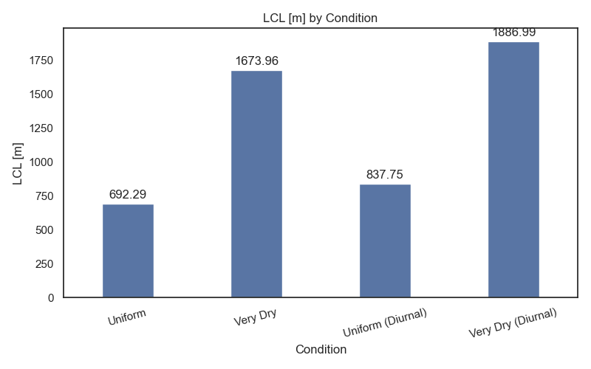

Slide 17
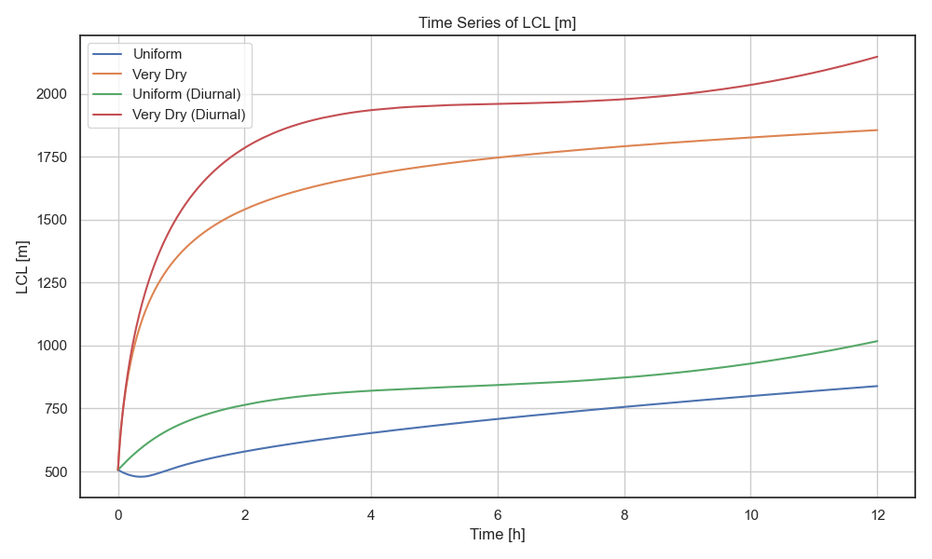

Slide 18
Is the potential temperature budget influenced by the different values of LCL?
A higher LCL typically means drier near-surface air and delayed condensation.
A positive correlation suggests that a higher LCL is linked with warmer potential temperature. If surface moisture is low, the LCL rises because the air needs to rise higher to cool enough to reach saturation.
The correlation heatmaps reveal a strong positive correlation between variables under both uniform and dry conditions.
Analysis of the bar plots further indicates that the diurnal cycle contributes to an increase in the LCL. This rise is attributed to its dependence on both temperature and humidity. During daytime, surface heating elevates near-surface air temperatures; however, specific humidity does not typically increase at a comparable rate unless significant evaporation or transpiration occurs. As a result, the increased temperature without a corresponding moisture increase leads to a higher LCL. This mechanism also accounts for the upward trend observed in the timeseries.
Under drier conditions, the LCL is consistently higher. This is because low relative humidity implies that the air parcel is further from saturation, requiring greater lifting (and cooling) before condensation occurs.

Slide 19
Is the potential temperature budget influenced by the different values of LCL?
The potential temperature budget is influenced by different values of the LCL both directly and indirectly, through their effect on turbulence, mixing, and phase changes in the boundary layer.
LCL Condition | Effect on θ Budget
Low LCL | Earlier latent heating → increased θ near surface, deeper mixing, stronger turbulent flux divergence
High LCL | Delayed/no condensation → less θ increase from latent heating, shallower mixing, more stable stratification

Slide 20
Under which conditions are boundary layer clouds formed and at which height? Discuss which are the most favourable early-morning conditions for Δq to form boundary-layer clouds.
Boundary-layer clouds are most likely to form under uniform (diurnal) conditions, where LCL values are lowest (e.g., around 500–1000 m). These conditions show higher near-surface moisture q and larger Δq, especially during the early morning, indicating strong moisture gradients.
In contrast, very dry conditions exhibit high LCLs (often exceeding 1000 m) and low Δq, making them less favourable for boundary-layer cloud development.
The most favourable early-morning conditions for cloud formation occur when:
Δq is high, indicating moisture accumulation near the surface.
LCL is low, indicating air parcels can reach saturation with minimal lifting.
These conditions are typically observed in the uniform (diurnal) scenario, suggesting that diurnal variations in moisture and temperature play a key role in driving cloud formation.

Slide 21
The influence of the potential temperature jump (Δ𝜃) on the moisture budget
Building on the control case conditions, characterized by a moisture jump of Δ𝑞=−1 g kg−1, we now turn our attention to the influence of the potential temperature jump (Δ𝜃) on the moisture budget. In the following sections, we propose a series of numerical experiments designed to systematically investigate how variations in Δ𝜃 affect the vertical distribution and evolution of moisture within the boundary layer.

Slide 22
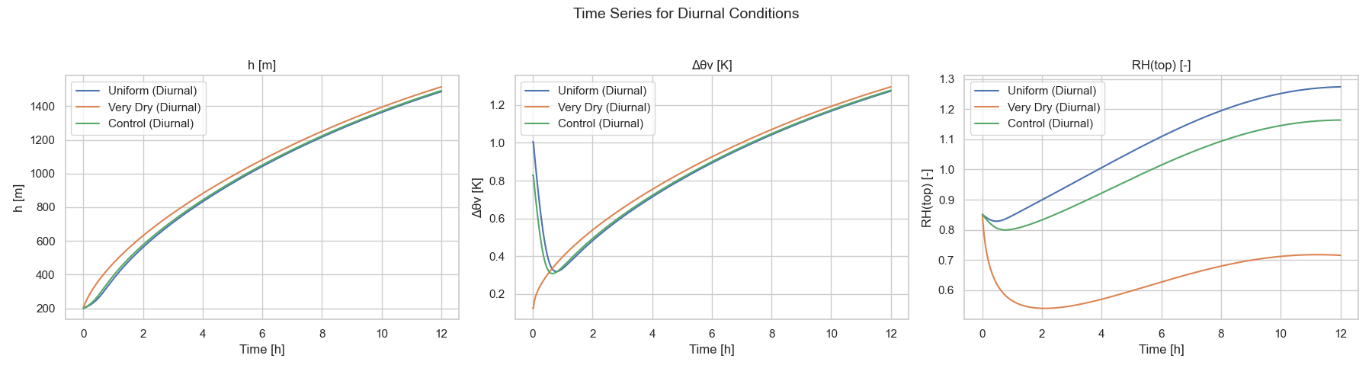
The influence of the potential temperature jump (Δ𝜃) on the moisture budget

Slide 23
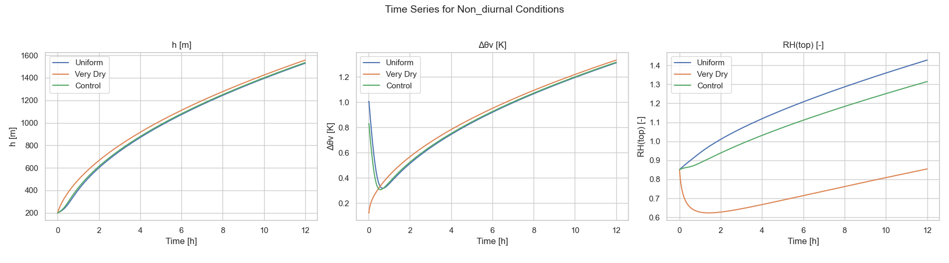
The influence of the potential temperature jump (Δ𝜃) on the moisture budget

Slide 24
The influence of the potential temperature jump (Δ𝜃) on the moisture budget
A drier free atmosphere facilitates the growth of the atmospheric boundary layer (ABL) by diminishing the jump in virtual potential temperature (Δθv), thereby weakening the strength of the capping inversion.
The graphs above illustrate the outcomes of the numerical experiments, specifically the temporal evolution of boundary layer height (h), the virtual potential temperature jump (Δθv), and the relative humidity at the top of the boundary layer (RHₜₒₚ) across three experimental setups characterized by different values of moisture contrast (Δq).
Compared to the reference scenario, the case with Δq = -5 g kg⁻¹ demonstrates a marked reduction in specific humidity due to enhanced drying. This reduction leads to an increase in the lifting condensation level (LCL) and a corresponding decrease in RHₜₒₚ, indicating a less favorable environment for cloud formation near the top of the ABL.

Slide 25


